Slide 1
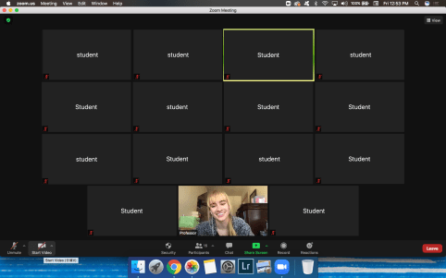
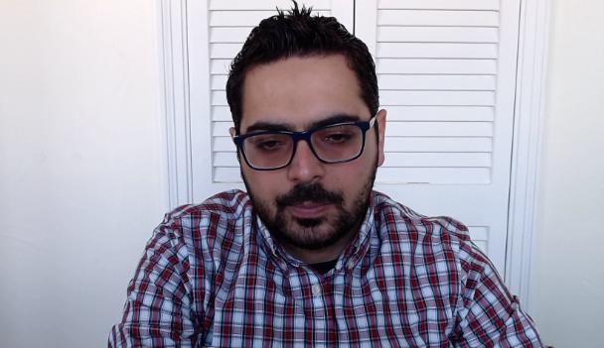

The Coffee
Seeing everyone’s faces creates for a more honest classroom experience.
Visual Cues for the Instructor(s)
The instructor can figure out if you understand the material or not without asking.
You can also use the chat for questions or concerns.
Having the camera on will help me to get to know you better.
If I recognize you in any coffee shop in any country, I will buy you a coffee ☺

Slide 2
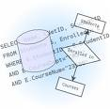

Database Management Systems
CS1555/2055 Flex@Pitt version
Teaching Assistants:
Rakan A. Alseghayer (Recitations)
Narsin Kalanat (Projects)
Gordon Lu (UTA)
Spring 2021 (2214, 21-2)
Instructor:
Constantinos Costa
Co-instructor:
Panos K. Chrysanthis
Data Rules

Slide 3
Why CS1555/2055? [Poll]
Top reasons to take CS1555/2055
My friends are taking it too
Works with my schedule
I wanna know how database systems work
I wanna do research in database systems
I want a job in/with database systems & Big Data

Slide 4
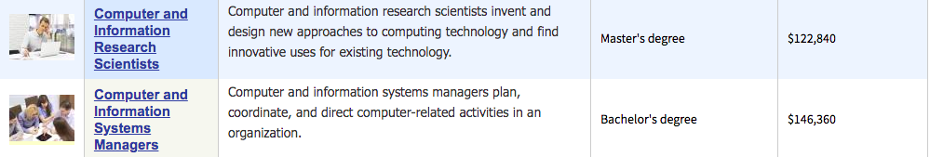
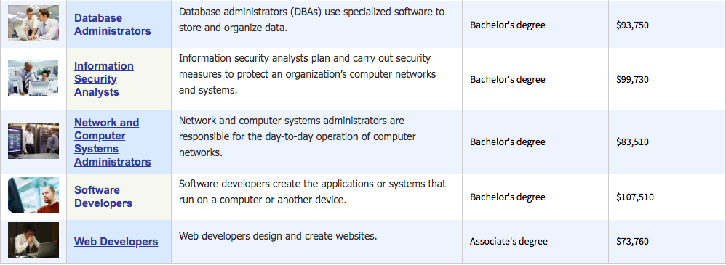
Some Recent Salary Numbers
[US Department of Labor: Friday, April 10, 2020]

Slide 5
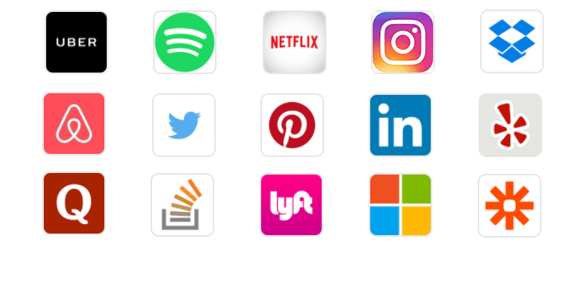
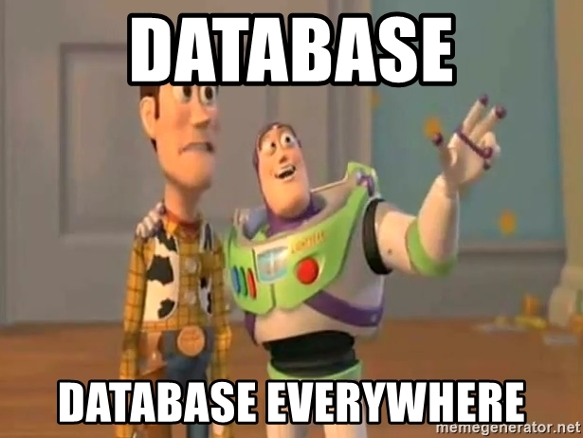
Databases everywhere

Slide 6
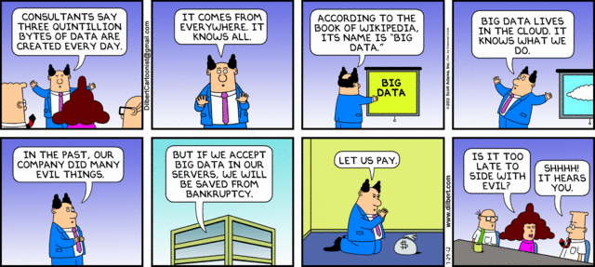
“Big” Data is an important problem
You know Big Data is an even more important problem if... It has a Dilbert cartoon!

Slide 7

Focus of the CS1555/2055 course
CS1555/2055: Application-oriented study of databases
Introduce fundamental concepts of data management
Design and use of a database system
Provide practical experience in applying these concepts using commercial DBMS
CS1656: Introduction to Data Science
Different data manipulation & data analysis techniques beyond traditional data management
CS2550: System-oriented study of databases
Design of database management system

Slide 8
Quick Facts - Lectures
When:
Synchronous Remote
Mon & Wed 1:15pm – 2:30pm @ 316 IS Building
Zoom links are available on Canvas
What:
Lecture Notes
Fundamentals of Database Systems, R. Elmasri and S. B. Navathe, 7th edition, 2015
Inclusive Access (RedShelf), Opt-out until Feb 05
PostgreSQL: The World’s Most Advanced Open Source Relational Database

Slide 9
Recitations
When & Where (1st Recitation Jan 22)
Friday, 1:15 pm - 2:05 pm
Friday, 3:25 pm - 4:15 pm
Recitation Zoom links are available under Recitations
What: Complements & goes beyond the lectures
solve problems & homework,
study more Examples,
practice with PostgreSQL,
it is required… attendance and participation in lecture and recitation may be used to decide borderline grades.

Slide 10
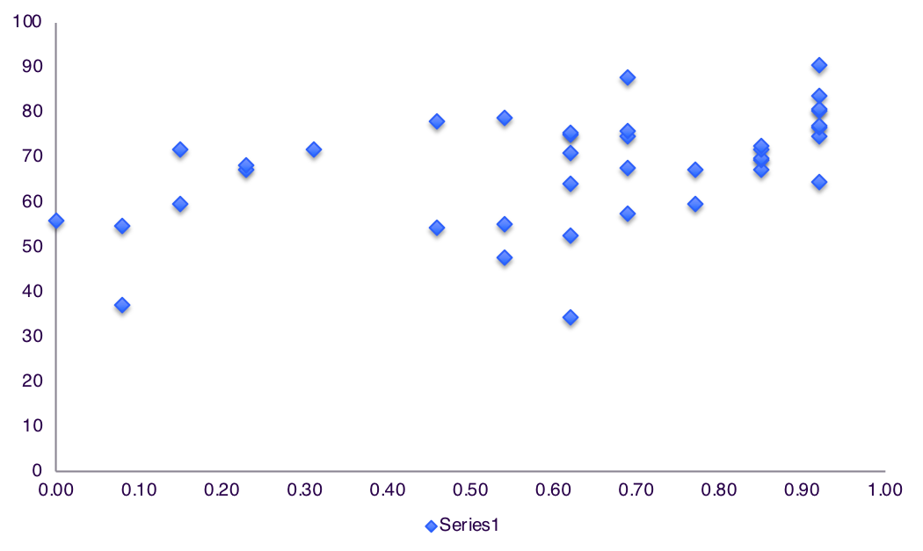
Recitation Attendance Vs. Scores
Total Points
% Recitations

Slide 11
Assessments - Grading
Assessment | Percentage | Dates
Homeworks | 20%
Project | 20%
Midterm Exam | 25% | Mar. 10, 2021
Final Exam | 25% | TBD
Participation (Class & Recitations) | 10%

Slide 12
Administrative
Web page: check often! http://db.cs.pitt.edu/courses/cs1555/current.term http://db.cs.pitt.edu/courses/cs2055/current.term
Class email: cs1555-staff@cs.pitt.edu
For confidential matters only
use keyword cs1555 in all emails to instructor/TA (as part of the subject line)
it works only within pitt.edu
Campuswire:
for all clarifications to lectures, recitations and assignments
Assignments:
To be submitted electronically
No campuswire or email clarifications 4 hours prior a deadline

Slide 13
Office Hours
 | Monday | Tuesday | Wednesday | Thursday | Friday
10am |  |  |  | Gordon Zoom Link
11am | Rakan Zoom Link |  | Rakan Zoom Link
12pm
1pm
2pm
 | Dr. Costa Zoom Link |  | Dr. Costa Zoom Link |  | Rakan Zoom Link
3pm |  | Nasrin Zoom Link |  | Nasrin Zoom Link
4pm |  |  |  |  | Gordon Zoom Link
 |  | Rakan Zoom Link |  | Rakan Zoom Link
5pm
6pm |  |  | Gordon Zoom Link
7pm |  |  |  | Gordon Zoom Link

Slide 14
Campuswire Guidelines
Remember that everything you post can been seen from everyone.
Please do not post any assignment code on Campuswire, even as a private message. Visit office hours for any code related questions.
Keep posts on Campuswire course-related.
Please read all questions and responses that are on Campuswire before asking a question. Utilize the excellent Campuswire search facilities.
Use a meaningful subject heading.
Make sure your questions/posts are in the appropriate category (e.g., hw0, hw1, hw2, ...).
Tag your post with all the applicable tags.
Please don't post things to the group that give no useful information.
Please keep complaints about the course out of the newsgroup. If you have a concern about anything to do with the course, please talk to the instructor.
Please be respectful of your peers and others in your posts.

Slide 15
Overview of Database Management Systems
Notes:
Definitions
Advantages
System Architectures

Slide 16
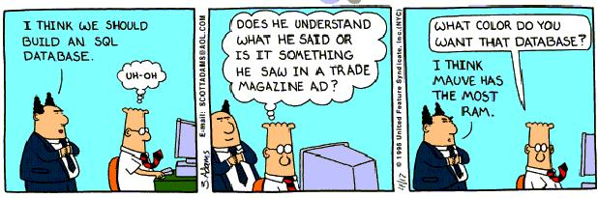
What is a Database ? [Poll]

Slide 17
What is a database?
A very large, integrated collection of related data
data is raw facts on some aspect of the world
Models a real-world enterprise (e.g., university)
Entities (e.g., students, courses)
Relationships (e.g., Bob took CS 1550)
Students
Courses
Enrollment
SID | Name | Age | GPA
546007 | Susan | 18 | 3.8
546100 | Bob | 19 | 3.65
546500 | Bill | 20 | 3.7
CID | CName
CS 1555 | DB
CS 1530 | SW
CS 1550 | OS
SID | CID | Grade
546007 | CS 1550 | A
546007 | CS 1530 | B+
546100 | CS 1550 | B
Notes:
Data = bytes + types
Information = data + semantics
Any random collection of data is not a database

Slide 18
Data vs. Information
Bits + Type = Data
Data + Semantics = Information
Information + Model = Knowledge

Slide 19
Integrated Data
All data are stored and manipulated in a uniform way on a secondary storage
Databases store large amounts of data that cannot fit in main memory.
Data are stored for long and indefinite period
Data are shared across multiple applications

Slide 20
What is a Database Management System?
Database Management System (DBMS):
A general purpose software package designed to store and manage databases conveniently & efficiently
DBMSs:
Oracle, IBM DB2, SQLServer, MySQL, PostgreSQL …
Usage: Database system = DB + DBMS + Application Logic
Resource Planning Applications:
PeopleSoft, SAP, …
Web-based Applications:
amazon.com, ebay, google, …

Slide 21
Database Management System (DBMS)
Application
Programmers
Web
Forms
Embedded
SQL
Interactive
SQL
Applications
SQL Commands
DBMS
Query
Evaluation Engine
Database Implementor
Concurrency
Control
Files and Access Methods
Recovery
Manager
Buffer Manager
Disk Space Manager
System Catalog
Index Files
Data Files
Database Administrator
Database
Notes:
Better figure/components

Slide 22
Approaches to management of data
File system approach
Traditional (flat) files +
C (Java, ...) programs to access them
E.g., use one (or more) UNIX/DOS files, with student records and their courses
Decide on a layout for the student records, etc.
Database approach

Slide 23
File Approach to Data Management
Write everything to text files!
Have your applications directly read/write to these files
Problems?
Slow!
Have to constantly enforce layout of data
What if multiple instances of your application need to read/write to the same file at the same time?
What if one of them crashes?
Notes:
You’ve all had to write projects that managed some data before, how did you do it?
Other end of the spectrum

Slide 24
Database Vs. File Systems Approaches
Abstraction
Reliability
Efficiency/Performance

Slide 25
Performance Requirements
Abstraction
Data abstraction
Execution abstraction
Reliability
High availability: recovery time is short
Trusted/Quality data
Efficiency/Performance
High throughput
(Committed transactions per unit time)
Short or bounded response time
Energy Efficiency

Slide 26
Topics for the Term
1 | Relational Model
2 | DDL
3 | Relational Algebra
4 | DML & VDL
5 | Access Control
6 | Transactions
7 | Integrity Constraints
8 | Database Programming
9 | Normalization
10 | ER Modeling
11 | File Storage & Indexing
12 | Query Processing
13 | Concurrency Control
14 | Recovery
Theory
Systems
SQL/Programming

Slide 27
Agenda for 1st Recitations
Introduction to Relational Model
Introduction to the used DB Technologies
PostgreSQL Server
Datagrip IDE
Please “bring your laptops” to do the installation of these software together during recitations.

